Slide 1

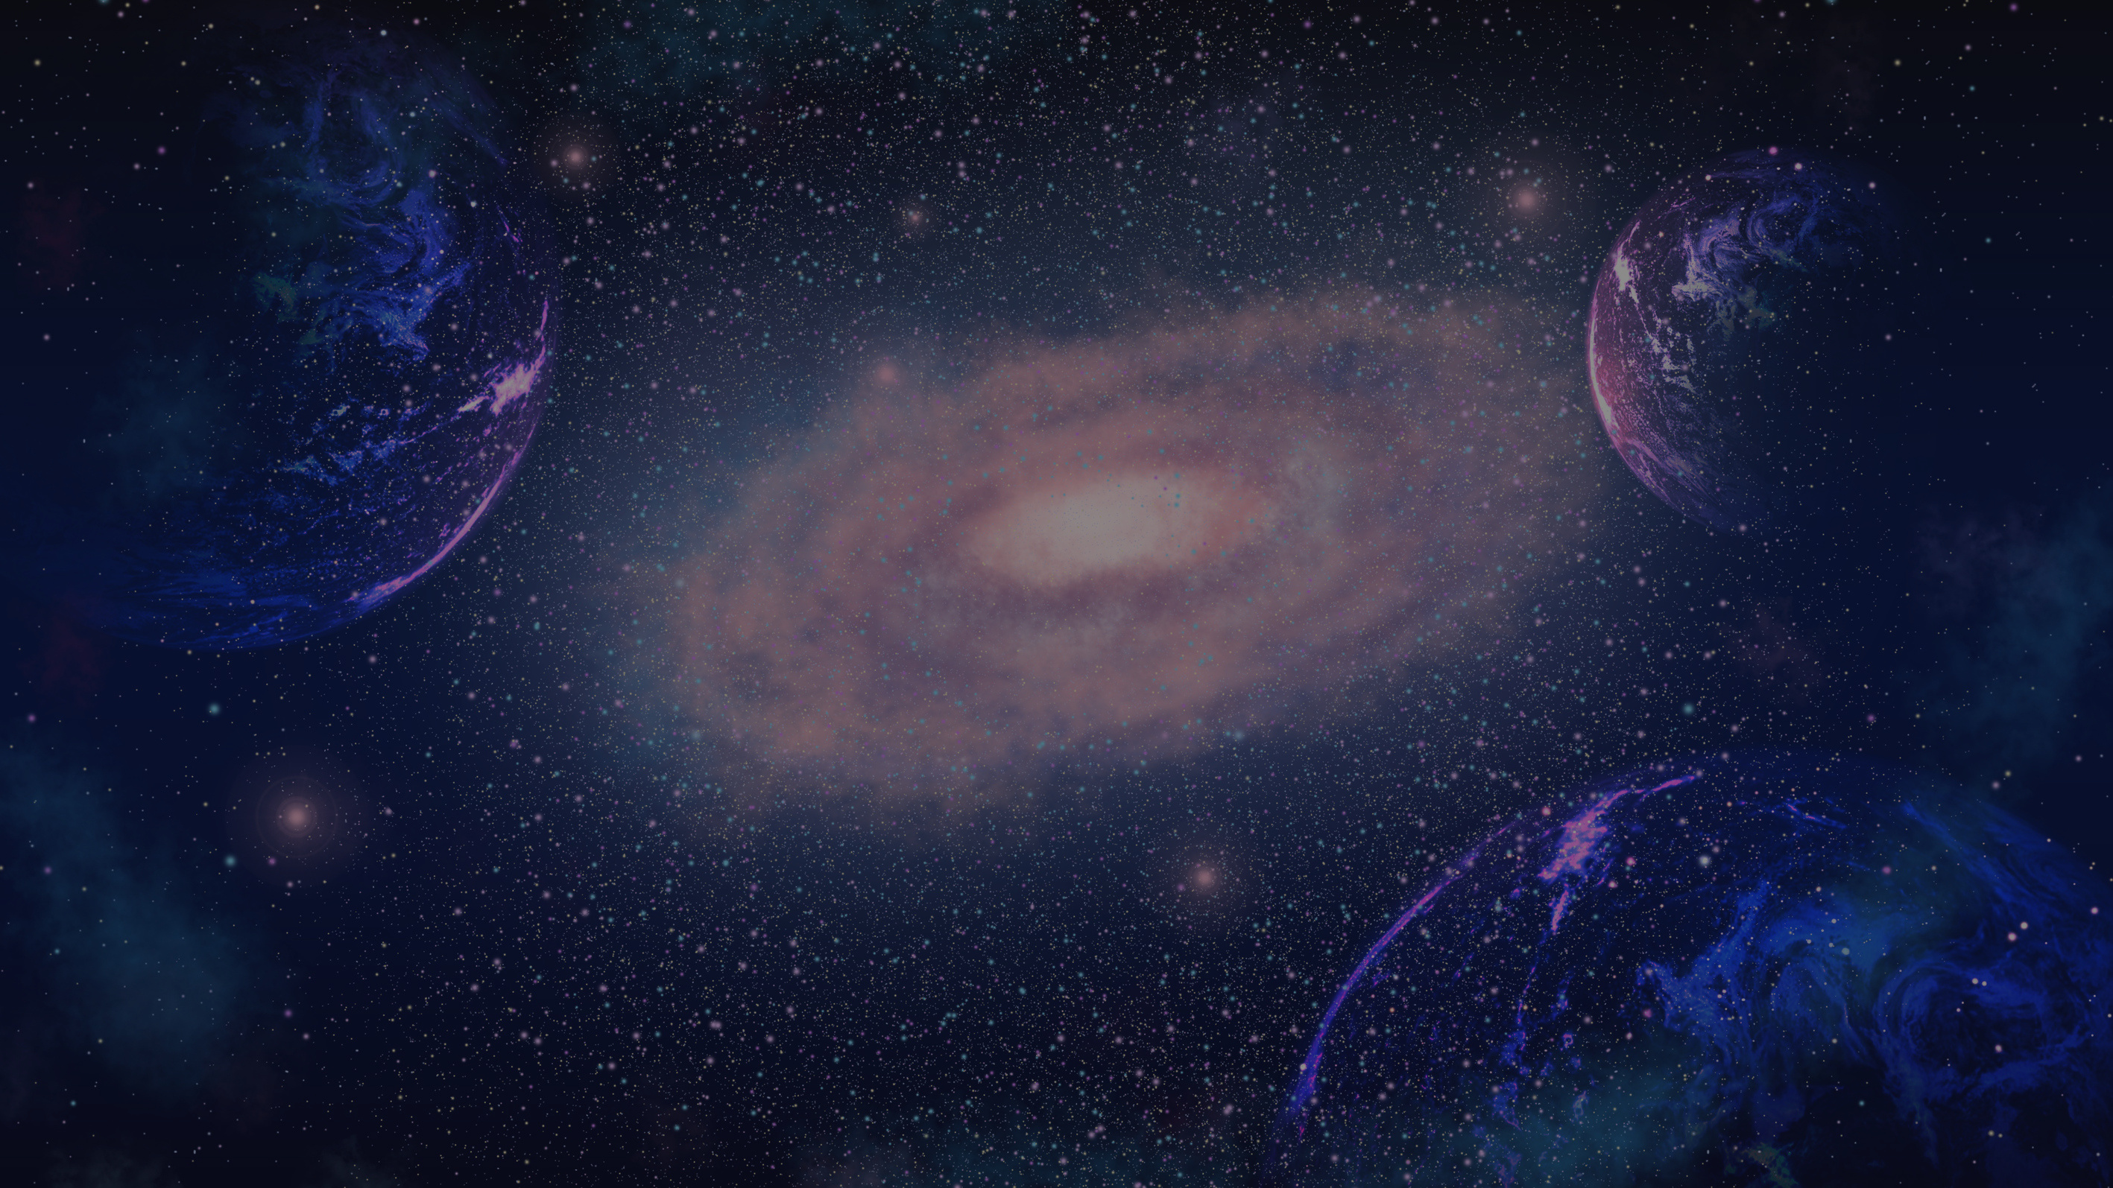

PROJECT PRESENTATION
STELLAR OBJECT CLASSIFICATION

Slide 2
AGENDA
Introduction
Problem Statement
Data Gathering
Data preprocessing
EXPLORATORY DATA ANALYSIS
Feature Engineering
Feature Extraction
Model Selection
Model Training
Hyper Parameter Tuning

Slide 3
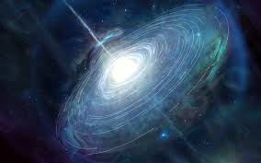
INTRODUCTION
Quasars: Quasars are extremely bright objects powered by supermassive black holes at the centers of distant galaxies. They release massive energy and are among the brightest objects in the universe.
Galaxies: Galaxies are vast systems of stars, gas, dust, and dark matter, held together by gravity. They come in various shapes and sizes, and are the primary structures in the universe.
PAGE 01
PROJECT PRESENTATION

Slide 4

PROBLEM STATEMENT
classify celestial objects into stars, galaxies, and quasars. This project aims to faciltate efficient automated classification, insights into distinguishing features, and optimized data processing for large-scale surveys through the predictive models, data visualizations, and a comparative analysis of various algorithms.
PAGE 02
PROJECT PRESENTATION

Slide 5
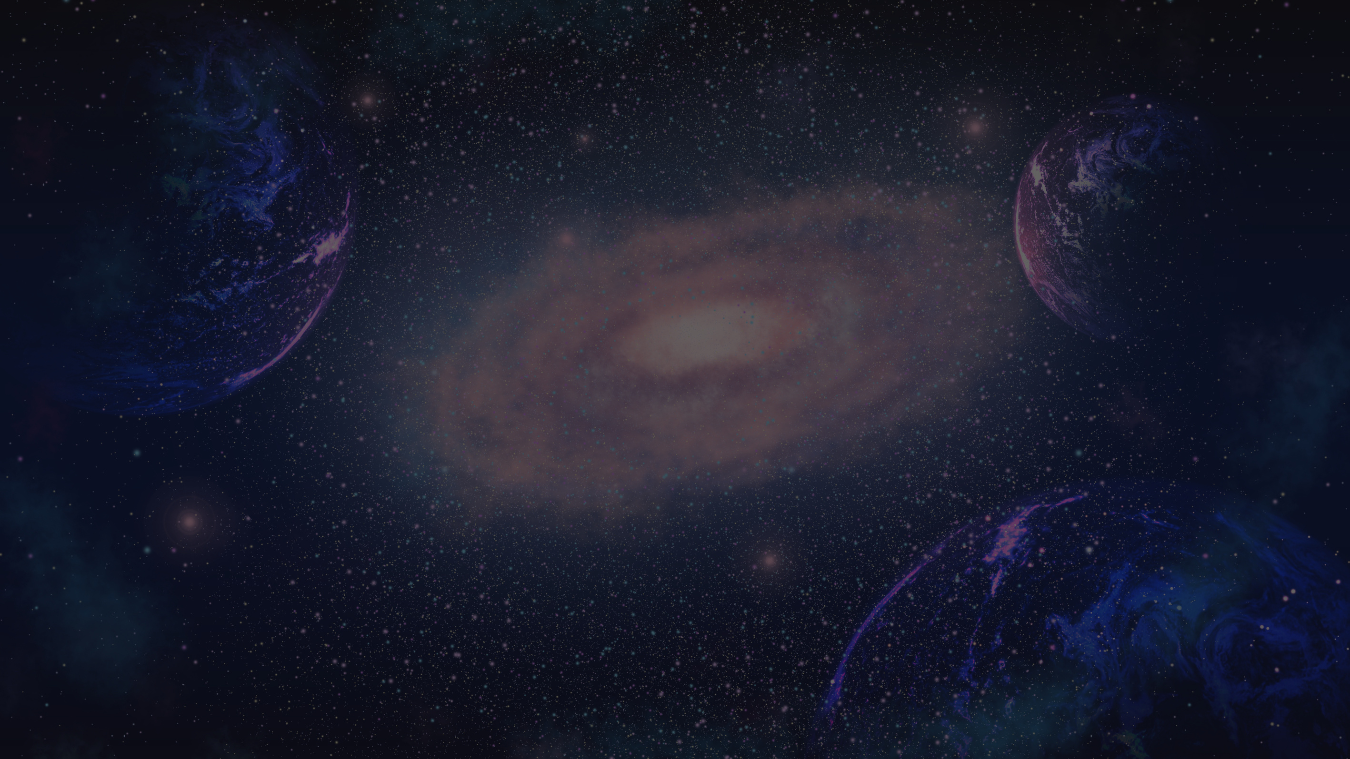
DATA PREPROCESSING
REMOVE IRRELEVANT COLUMNS:
HANDLING MISSING VALUES:
Drop ID columns (obj_ID, run_ID, rerun_ID, cam_col, field_ID, spec_obj_ID, plate, MJD, fiber_ID) as they don’t contribute to classification.
Check for missing values in relevant columns (alpha, delta, u, g, r, i, z, redshift).
Impute missing data if necessary (e.g., mean, median), or remove rows with missing values if imputation is not feasible.
DATA COLLECTION:
Normalize or standardize numerical features (alpha, delta, u, g, r, i, z, redshift) to ensure uniform feature scaling:
Min-Max Scaling: For normalization to a range of 0-1.
Standardization: To have mean 0 and standard deviation 1.
FEATURE SELECTION:
Retain only the key features: alpha, delta, u, g, r, i, z, redshift.
Analyze correlations between features to eliminate any highly correlated features that may add redundancy.
PROJECT PRESENTATION
PAGE 03

Slide 6





DATA GATHERING
PROJECT PRESENTATION
The data consists of 100,000 observations of space taken by the SDSS (Sloan Digital Sky Survey). Every observation is described by 17 feature columns and 1 class column which identifies it to be either a star, galaxy or quasar.
obj_ID = Object Identifier, the unique value that identifies the object in the image catalog used by the CAS
alpha = Right Ascension angle (at J2000 epoch)
delta = Declination angle (at J2000 epoch)
u = Ultraviolet filter in the photometric system
g = Green filter in the photometric system
r = Red filter in the photometric system
i = Near Infrared filter in the photometric system
z = Infrared filter in the photometric system
run_ID = Run Number used to identify the specific scan
rereun_ID = Rerun Number to specify how the image was processed
cam_col = Camera column to identify the scanline within the run
field_ID = Field number to identify each field
spec_obj_ID = Unique ID used for optical spectroscopic objects (this means that 2 different observations with the same spec_obj_ID must share the output class)
class = object class (galaxy, star or quasar object)
redshift = redshift value based on the increase in wavelength
plate = plate ID, identifies each plate in SDSS
MJD = Modified Julian Date, used to indicate when a given piece of SDSS data was taken
fiber_ID = fiber ID that identifies the fiber that pointed the light at the focal plane in each observation
PAGE 04

Slide 7
DATA PREPROCESSING
CLASS LABEL CONVERSION:
DATA SPLITTING:
Ensure the class column (galaxy, star, quasar) is labeled numerically:
Galaxy = 0, Star = 1, Quasar = 2 (if not already numerically labeled).
Split the data into training and testing sets (e.g., 80% training, 20% testing) to evaluate model performance.rs.
OUTLIER DETECTION:
Detect and remove any extreme outliers in features like redshift, which could negatively affect model performance.
PROJECT PRESENTATION
PAGE 05

Slide 8
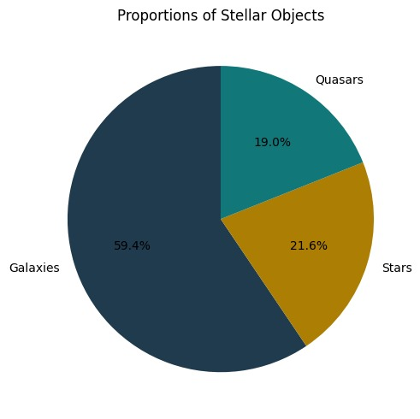
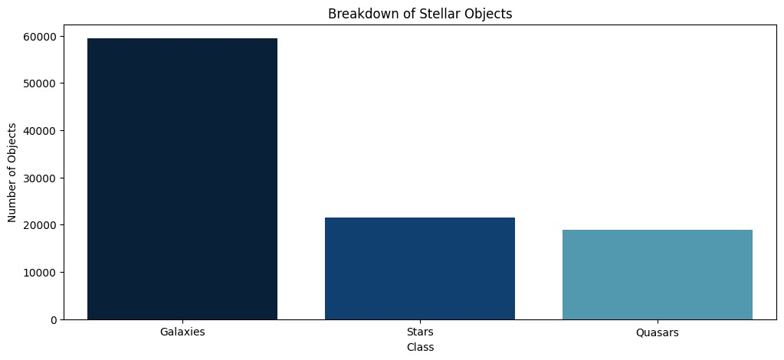
EXPLORATORY DATA ANALYSIS
Distribution Analysis: What is the distribution of stars, galaxies, and quasars in the dataset? How are they represented in terms of frequency and proportions?

Slide 9
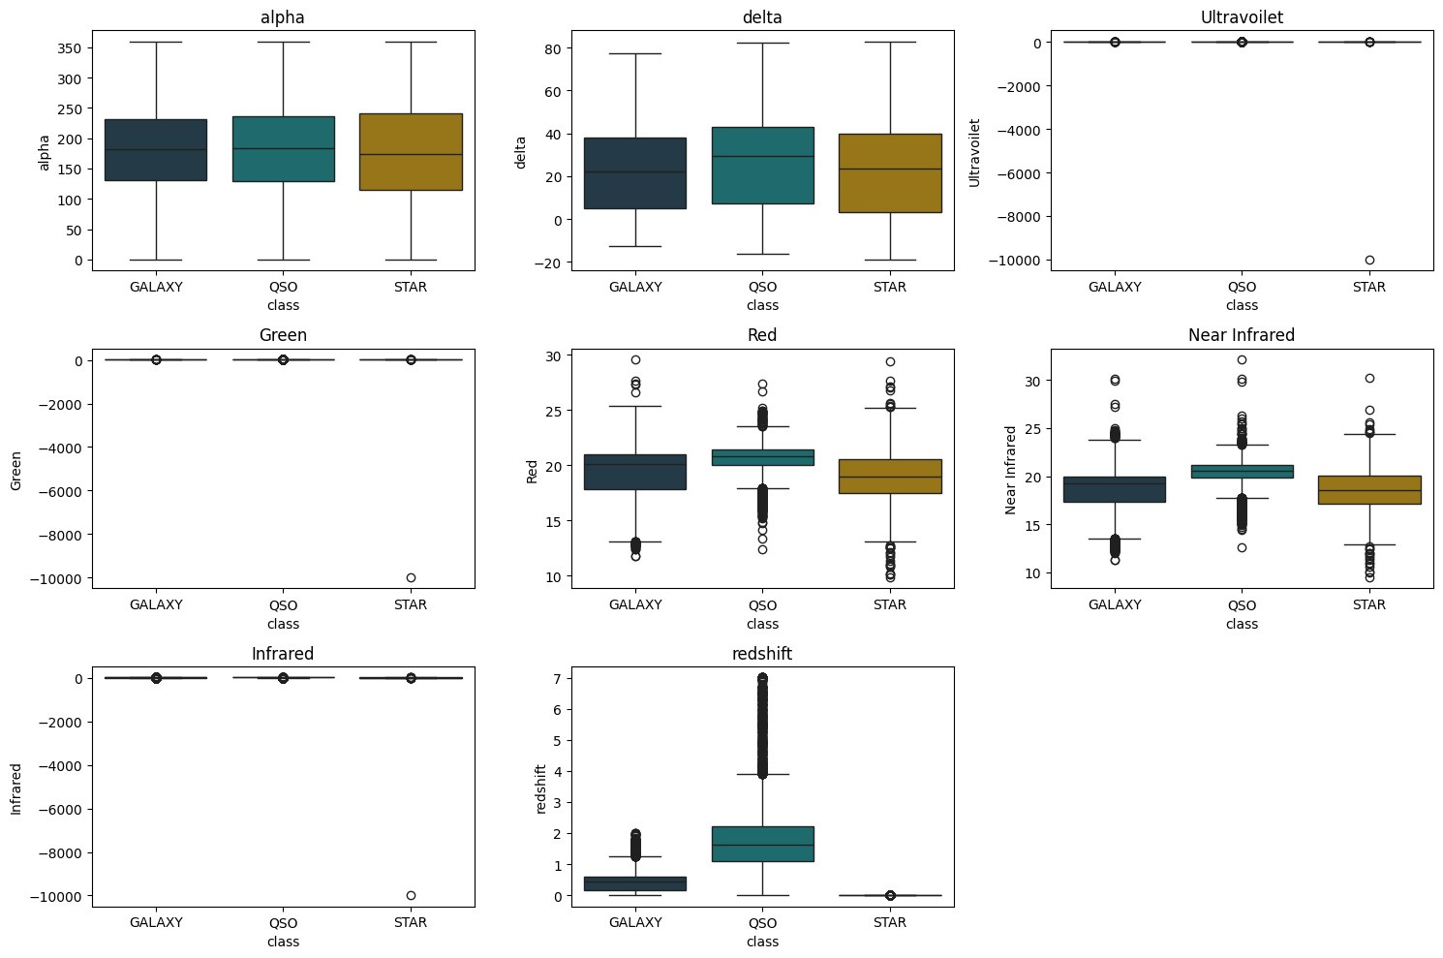
PROJECT PRESENTATION
EXPLORATORY DATA ANALYSIS
Outlier Detection: Are there any outliers in the data that don’t fit well with stars, galaxies, or quasars? What could these outliers represent, and how should they be handled in the analysis?

Slide 10
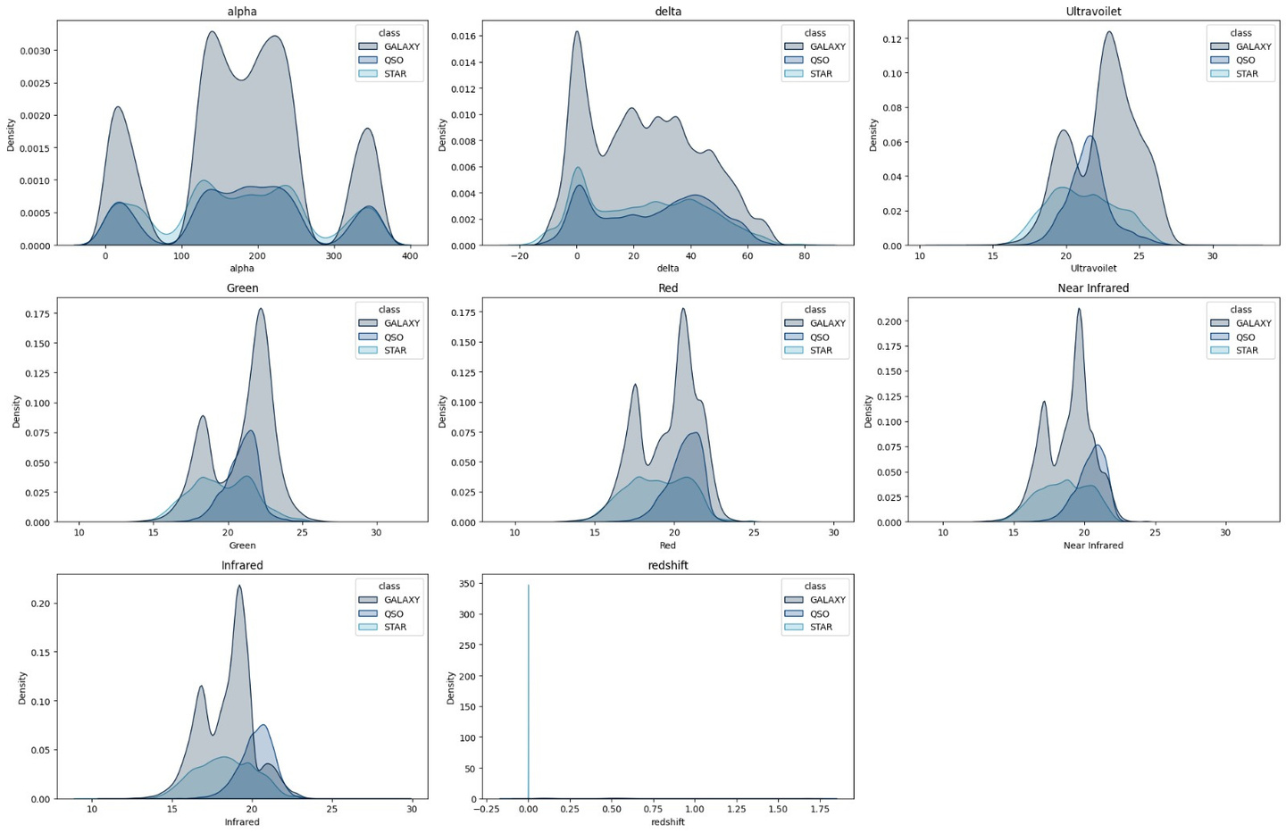
PROJECT PRESENTATION
EXPLORATORY DATA ANALYSIS
Class Overlap: Are there regions in feature space where stars, galaxies, and quasars overlap significantly? How can this be resolved with additional features or classification techniques?

Slide 11
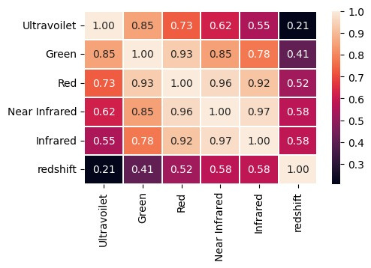
PROJECT PRESENTATION
EXPLORATORY DATA ANALYSIS
correlation

Slide 12
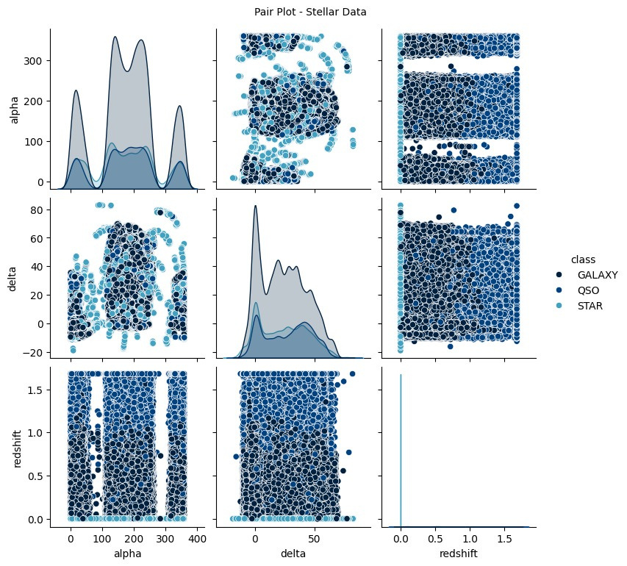
PROJECT PRESENTATION
EXPLORATORY DATA ANALYSIS
The correlation between alpha, delta, and redshift shows that these features are not strongly correlated.
In the dataset, alpha (right ascension) and delta (declination) represent the positional coordinates of celestial objects, while redshift measures the object's velocity and distance relative to the observer. The weak correlation between these features indicates that an object's position in the sky is independent of its redshift. This suggests that positional information doesn't significantly impact the redshift values, which are more influenced by the object's movement and distance in the expanding universe.

Slide 13
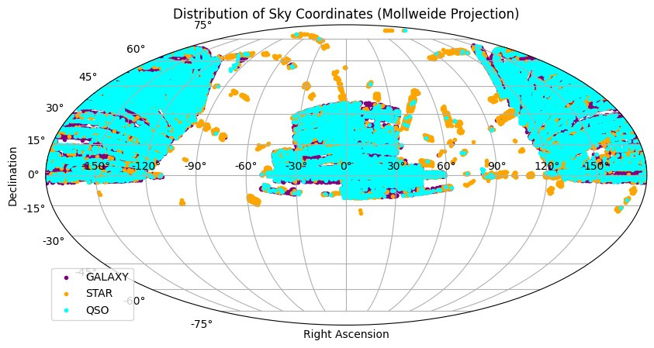
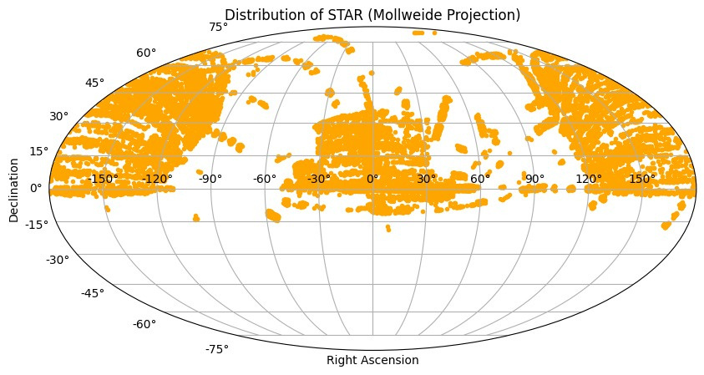
PROJECT PRESENTATION
EXPLORATORY DATA ANALYSIS
Spatial Distribution: What is the spatial distribution of stars, galaxies, and quasars? Are they uniformly distributed, or are there notable patterns (e.g., galaxy clusters, voids)?

Slide 14
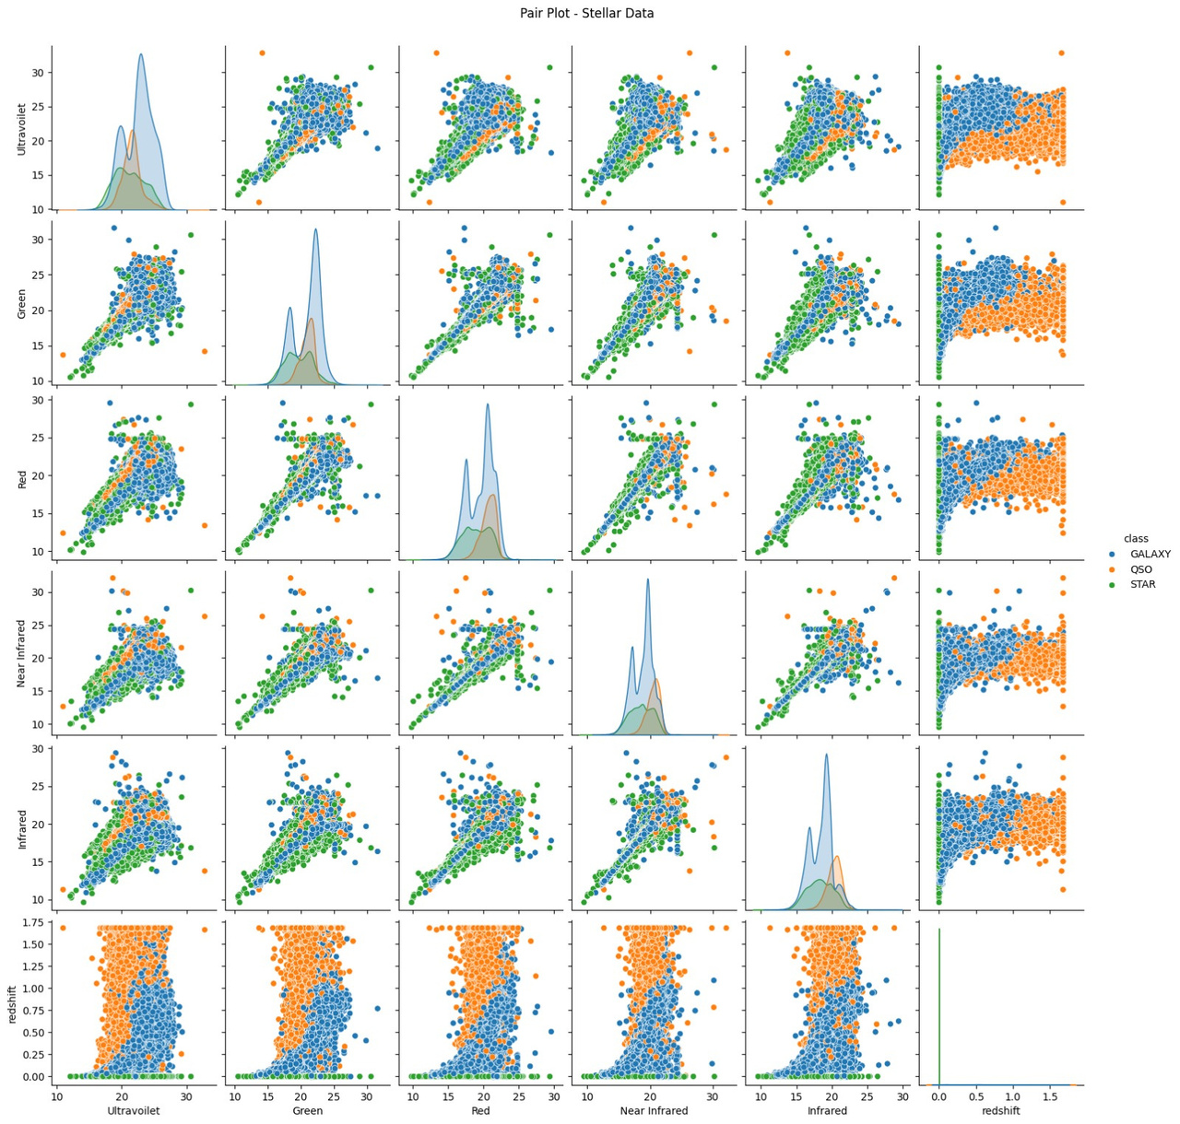
PROJECT PRESENTATION
EXPLORATORY DATA ANALYSIS
Linearity plot

Slide 15
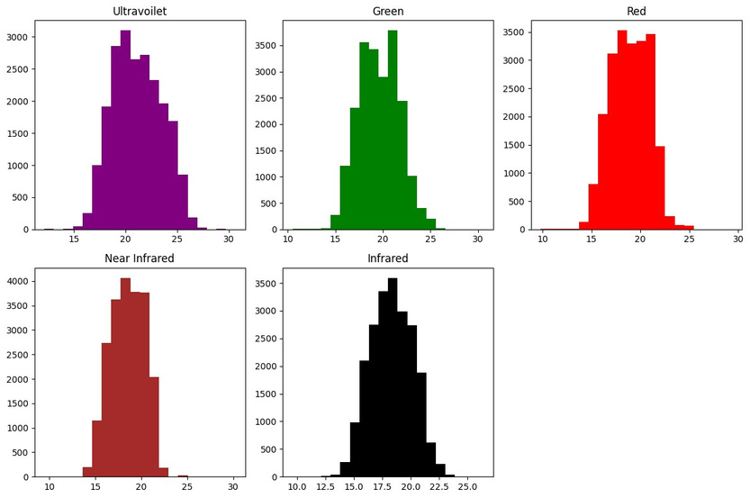
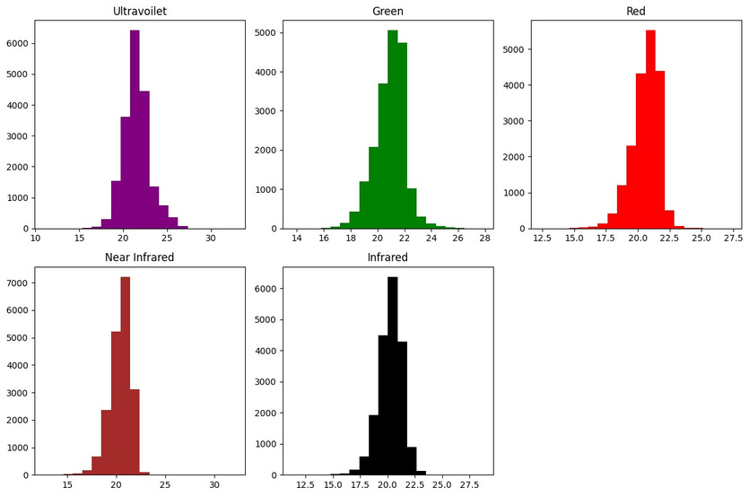
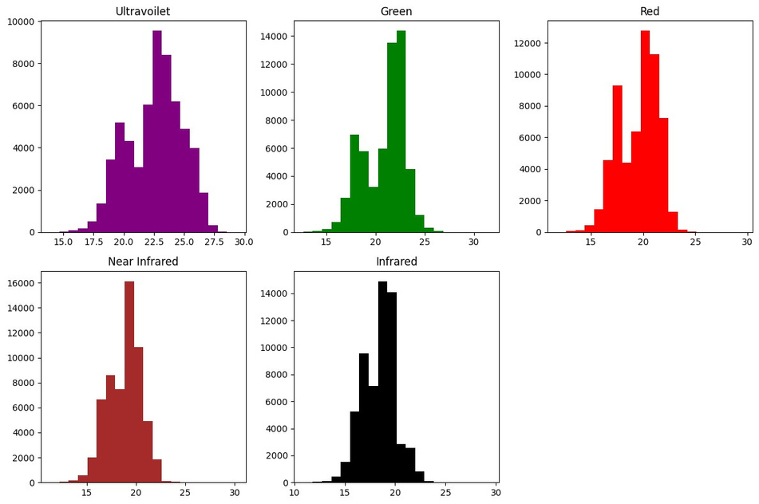
PROJECT PRESENTATION
EXPLORATORY DATA ANALYSIS
Spectral Properties: How do the spectra of stars, galaxies, and quasars differ? Are there specific patterns or ranges of wavelength values that uniquely identify each class?

Slide 16
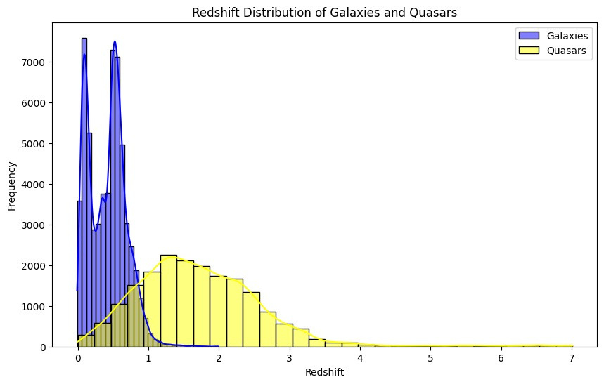
PROJECT PRESENTATION
EXPLORATORY DATA ANALYSIS
Redshift Distribution: What is the redshift distribution of galaxies and quasars? How does it differ between the two, and what does this tell us about their locations in the universe?

Slide 17



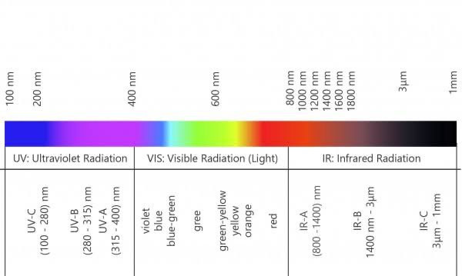
PROJECT PRESENTATION
FEATURE ENGINEERING

Slide 18
PROJECT PRESENTATION
FEATURE ENGINEERING
THE SUBTRACTION OF VALUES IN THE FEATURIZE FUNCTION IS LIKELY CREATING NEW FEATURES THAT CAPTURE THE DIFFERENCE BETWEEN DIFFERENT BANDS OF LIGHT. THIS IS A COMMON TECHNIQUE IN ASTRONOMY, ESPECIALLY WHEN DEALING WITH SPECTRAL DATA.
Here's a breakdown of what each subtraction might represent:
g-r: This represents the difference between the green and red bands. It can be used to identify objects with a specific color or spectral signature, such as red giants or blue stars.
i-z: This represents the difference between the infrared and z-band. It can be used to identify objects that emit strongly in infrared, such as dusty galaxies or cool stars.
u-r: This represents the difference between the ultraviolet and red bands. It can be used to identify objects with strong ultraviolet emission, such as hot, young stars.
i-r: This represents the difference between the infrared and red bands. It can be used to identify objects that emit strongly in infrared, such as dusty galaxies or cool stars.
z-r: This represents the difference between the z-band and red bands. It can be used to identify objects that emit strongly in the z-band, such as distant galaxies.
By creating these new features, the model can potentially learn more complex patterns in the data and improve its accuracy.
WHY ARE WE PERFORMING BECAUSE THERE IS HIGH CORRELATION BETWEEN THE WAVELENGTHS

Slide 19
PROJECT PRESENTATION
FEATURE EXTRACTION
REDSHIFT IMPORTANCE: REDSHIFT IS CONSIDERED A HIGHLY IMPORTANT FEATURE AS IT PROVIDES CRITICAL INFORMATION ABOUT THE OBJECT'S VELOCITY AND DISTANCE. DUE TO HIGH CORRELATION BETWEEN WAVELENGTHS, WE CAREFULLY SELECT FEATURES LIKE REDSHIFT TO REDUCE REDUNDANCY AND FOCUS ON FEATURES WITH HIGH PREDICTIVE POWER.

Slide 20




PROJECT PRESENTATION
MODEL SELECTION
Multiple models are evaluated, The selection is based on the log loss for training, testing, and validation errors. The best-performing model is chosen for further tuning.
1
2
3
K-Nearest Neighbors (KNN)
Support Vector Machines (SVM)
Decision Tree, Random Forest
4
5
AdaBoost
Gradient Boosting, and XGBoost
PAGE 18

Slide 21
The data is split into 60% for training, 20% for testing, and 20% for cross-validation. This split ensures the model is well-trained and evaluated across unseen data, improving its generalizability. The selected model is trained on the training set, and then tested and validated on the remaining data to minimize overfitting and improve performance.
This process ensures that the model is well-structured, optimized, and ready for further fine-tuning based on evaluation metrics.
60% FOR TRAINING
20% FOR TESTING
MODEL TRAINING
20% FOR CROSS-VALIDATION
PROJECT PRESENTATION
PAGE 19

Slide 22
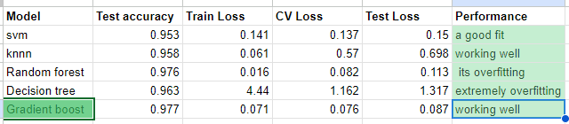
HYPER PARAMETER TUNING
Hyper parameter running is done on gradient boost classifier as it has reduce the mild over fitting
gradient boosting has high accuracy and we applied hyperparameter running that
PROJECT PRESENTATION
PAGE 19

Slide 23

THANK
YOU

